Slide 1
“Social work research and accountable practice –challenging dogma in uncertain times”
Walter Lorenz
Free University of Bozen, Italy

Slide 2
hypothesis
Social work research, particularly with regard to methodology, must critically consider the political and societal context in which it takes place so as not to play into the hands of a particular ideology unwittingly

Slide 3
Exponential growth of knowledge
Up to 1900: amount of knowledge doubles every 100 years
2016: number of scientific publications doubles every 9 years
The searchable web currently contains about 5 billion webpages online

Slide 7
Growth of data volume
Buckminster Fuller created the “Knowledge Doubling Curve”; he noticed that until 1900 human knowledge doubled approximately every century. By the end of World War II knowledge was doubling every 25 years. Today things are not as simple as different types of knowledge have different rates of growth. For example, nanotechnology knowledge is doubling every two years and clinical knowledge every 18 months. But on average human knowledge is doubling every 13 months. According to IBM, the “internet of things” will lead to the doubling of knowledge every 12 hours …
BUT: IS IT KNOWLEDGE OR INFORMATION???

Slide 8
Challenges of the information society
how do we come from data to information,
from information to knowledge,
from knowledge to meaning
from meaning to prediction?
Are speed and automation the cause of much greater problems, do they mean an overall increase in our vulnerability, not only from hackers and terrorists, but through our dependence on often unaccountable experts to whom enormous power is being handed?

Slide 9
Big Data and the Human Factor:
Who is responsible for accidents caused by self-driving cars?
IBM’s supercomputer “Watson” when programmed to assist doctors in cancer diagnosis produced a match of 99% with that of oncologists.
What is more, it found treatment options that doctors missed in 30% of cases, and this on the basis of its vast store of research data with which it has been programmed – but how reliable are those research data?

Slide 10
Indicators of growing complexity (Jessop, 2007)
Greater inter-dependence of systems combined with functional differentiation
Increased fuzziness of institutional boundaries
De-hierarchisation of social relations between social entities (economic agents, states, civil society actors)
Acceleration of the rate of change through increased data flows
Multiplication of options of identity
Increased value of knowledge and knowledge systems in order to cope with constant changes
The self-potentiating nature of complexity, complex systems create opportunities for additional complexity.

Slide 11
Modernity, acceleration and growing complexity necessitated social work as the application of science
Professional methodology through inductive research (case studies, Charity Organisation Society, “Social Diagnosis” by Richmond and Salomon): anti-moralistic, systematic gathering of life stories
Deductive response: use of psychoanalytic theories; structural theories of poverty and disadvantage
In general – social work had to be oriented on “science”, particularly through indigenous research topics, projects and professorships in social work itself

Slide 12
Research paradigms in specific political contexts: structural functionalism (Parsons), 1960s-70s
Intervention methods based on positivist research made a contribution to the welfare state project
Helped to establish “bureau-professionalism” in social work
Heavy dependence on research conducted in other disciplines (sociology, psychology)
Instrumental use of research; objectifying

Slide 13
Research paradigms in specific political contexts: “cultural turn” 1970s-90s
“The Client Speaks” (Meyer and Timms, 1970): research as ‘giving voice’; clients as ‘experts’
Social movements articulate issues of diversity and identity (instead of promoting scientific universalism);
Critique of “paternalist universalism” of welfare state
Challenge to the monopoly of power by professional experts
Methodological fuzziness
Social work an ‘art’, not science
Lack of underpinning in phenomenological concepts in social work (except in social pedagogy, see Hans Thiersch: “Alltagsorientierung”, lifeworld competences)

Slide 14
‘The elevation of social constructionism within social and psychological sciences reflects a number of changes in society including the loss of faith in technocratic expertise, and the emerging power of new social movements to redefine the social world….‘
Moreover: constructionism is a response to the demise of positivism, the failure of hermeneutics to address issues of power, the loss of faith in Marxist social theory after 1989
(Stan Houston, 2001)

Slide 15
Research paradigms in specific political contexts: post-structuralism, 1980s-00s
Feyerabend “Against Method”: scientific objectivity = only one narrative among many
Difference between science and humanities is relative
Social constructivism in research methodology corresponds to social practice as inter-subjectivity
Neo-liberal politics disclaim structural solutions
Rise of individualism and emphasis on “human agency”
Economics instead of sociology as guide for Thatcher / Reagan politics

Slide 16
New Public Management: demand for (cost-) efficiency based on “evidence”
Spurred authentic social work research
‘applied research’ becomes respectable
Involves practitioners directly in research
Ambiguity of concept of evidence (short/medium/long-term effects; cultural and national specificity)
Proliferation of studies and data practically unmanageable

Slide 17
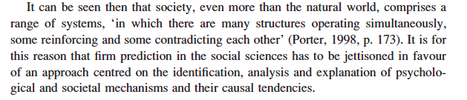
“Critical realism” (Bhaskar, 2008) as compromise?

Slide 18
Crisis of general confidence in science
– threat or opportunity?
Paradigm shift towards the ‘democratisation of science’:
‘post-normal science’ (Fundowicz & Ravetz, 1993),
‘post-academic research’ (Ziman, 2000),
Triple Helix (Etzkowitz and Leydesdorff, 2000)
‘New Production of Knowledge’ (NPK) or ‘Mode 2’ (M. Gibbons,C. Limoges, H. Nowotny, S. Schartzman, P. Scott and M. Trow (1994).
Unstructured, unauthorised information from indiscriminate sources (Wikipedia)
Reliability and truth yield to assertion, repetition, popular acclaim: relevance = usability, “social impact “

Slide 19
Research paradigms in specific political contexts: the “post-truth era” of politics, 2016 - …
“Unübersichtlichkeit” (Habermas 1985!!!) as political programme: exhaustion of ‘visionary’ (utopian) welfare models being replaced by individualised, fragmented lifestyle projects
Spread of social networks that “create facts” through constituting communities of ‘believers’
Ioannidis (2005): ‘Simulations show that for most study designs and settings, it is more likely for a research claim to be false than true. Moreover, for many current scientific fields, claimed research findings may often be simply accurate measures of the prevailing bias’

Slide 20
Bias in research
interests of funders determine research topics and reward results favourable to their interests
funding programmes prescribe topics to be researched which already have been identified as promising
The abundance of data and information itself creates problems because how can we find meaningful assessments by peer reviewers for the growing number of scientific publications (of which there are by now some 40M with DOI entry since its introduction in 2000)

Slide 21
Encyclopaedic knowledge

Slide 22
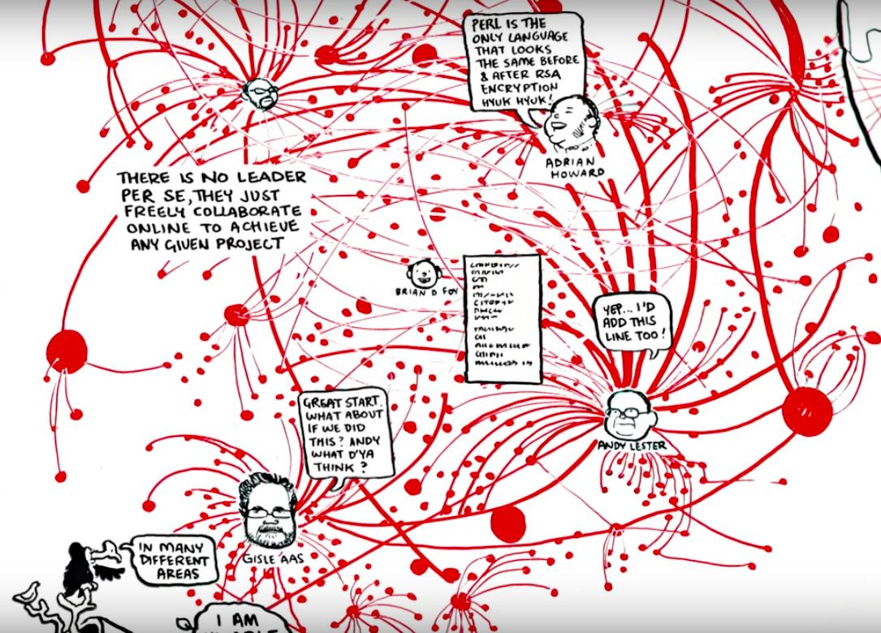
Web of knowledge creation

Slide 24
Scientific ‘facts’ have little impact on people’s attitudes and beliefs
according to a recent Pew Research Poll, the opinions of average Americans do not line up with the current scientific consensus when it comes to
safety of genetically modified organisms (GMO’s);
use of animals in research;
safety of foods grown with pesticides;
the role of human activity in climate change;
human evolution through natural selection;
dangers of overpopulation;
safety of nuclear power;
offshore drilling;
and safety of childhood vaccines.

Slide 25
Hyper- complexity / super-diversity

Slide 26
Searching for ‘evidence’ in research literature
a search for the keyword “child abuse” in JSTOR database yields 5739 results of relevant articles in scientific journals, and limiting the search to publications since 2001 still results in 1712 hits, specifying the topic to ‘prevention’ shows 669 finds.
Searching the databases available on the online catalogue of our university library for the keyword “truancy” yields 4382 results of articles dealing with this topic, of which 3105 were written after 2001, 1404 since 2011, all in English and available full-text online.

Slide 27
Implications for social work as a modern scientific project – despair, indifference or rising to the challenge?
Social work research supports accountability in the face of complexity
Accountability is not fulfilled by following regulations (this would be rationalisation, which according to Jabar Gubrium erases complexity and hence subjective meanings)
Hence accountability must aim at ‘making sense’
Making sense means creating relationships of shared meanings (beyond mere eventfulness and enactment which beg the question of how to transcend and communicate subjective meanings)

Slide 28
Today’s mandate of social work in societies faced with the crisis of modernity, the crisis of epistemology, with hyper-complexity and super-diversity is to give references for ‘making sense’ through research and practice
This does not consist in finding new models of knowledge creation, but of critically examining existing methodologies according to basic principles along the following dimensions

Slide 29
Scientific dimension
The scientific dimension is crucial, in as much as it requires taking position with regards a research methodology which is consistent and coherent rather than choosing methods arbitrarily and ad hoc.
Being committed to scientific principles means also developing a strong inter-disciplinary dimension as is the nature of social work anyway

Slide 30
Practice dimension
The practice dimension is an inalienable part of a social work research commitment, even where a project is geared towards a more basic understanding of phenomena, be that poverty or relationship difficulties.
The practice dimension also means that social work research always needs to have a participative dimension even where it is of a quantitative nature. We have a responsibility towards informants to give them a critical voice and to let them benefit from the outcomes of research. But ‘voice’ requires communicatively constituted communities

Slide 31
Ethical dimension
The ethical dimension is for social work research not just a preliminary formality, but all phases and aspects of a project need to be infused by ethical considerations. This means that researchers cannot adopt a normatively neutral position, nor does it mean that they adopt normative positions uncritically.
Researchers have to be aware that they themselves are intricately involved in normative systems and are carriers of norms on which they have to reflect continuously. From the perspective of research as sense-making, methodological questions become inseparable from ethical questions.

Slide 32
Political dimension
Social work research has a political dimension as the corollary of all the previously listed factors, if politics is to mean creating or at least promoting the conditions under which responsible changes in peoples lives can take place, not just at the individual level, but for the benefit of a community constituted by rights and hence by democratic principles of equality and freedom.

Slide 33
Making sense
‘making sense’ is not the solitary effort on the part of the experts – making sense can only happen in communication and in relationships, and this is where research and practice need to come together in social work; research is not completed with a publication, it goes on in discussions around the way questions and results can be shared with and hence transformed by those who matter to the project concerned.
In a society threatened by Post-Truth Politics, social work research has to be aimed at searching for truth and giving meaning, where many clients’ lives are threatened by senselessness.

